Slide 1


Ecommerce Product Categorization
Mantasha Maqbool

Slide 2
Problem Statement
In the rapidly evolving world of eCommerce, accurate product categorization is crucial for ensuring seamless customer experiences, reducing search friction, and increasing product discoverability. However, the sheer volume of diverse products poses a significant challenge. Current classification systems struggle to handle ambiguities, unconventional naming conventions, and multi-language data.

Slide 3
Objectives:
This hackathon focuses on creating accurate and efficient solutions for eCommerce product categorization.

Slide 4

Problem Solving Approach
Analyze the Dataset
Visualize the Data
Address Class Imbalance:
Develop Machine Learning/Deep Learning Models - Multi-class text classifier:
Fine-Tune Models:
Predict on Test Data:
Preprocess the Data
Feature Engineering/Text to Features:
Evaluate Model Accuracy and Other Metrics:

Slide 5
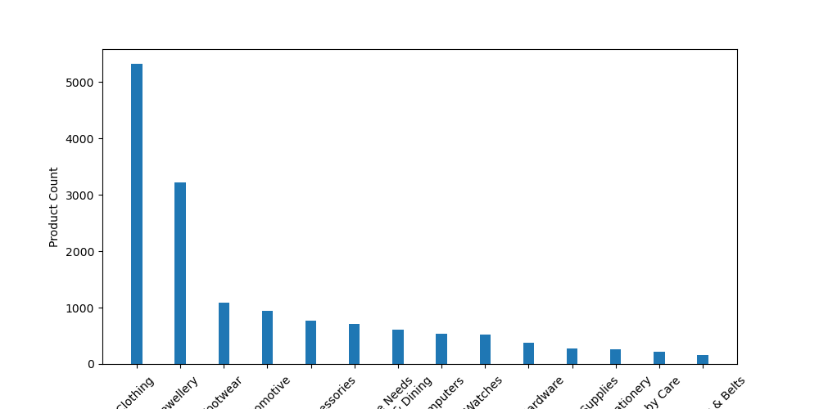

Slide 6
Key Insights
The online platform highest selling product category is Clothing followed by Jewellery.
01
The online platform has moderate sales in categories such as Footwear, Automotive, Mobiles & Accessories, Home Décor & Festive Needs, Kitchen & Dinning, Computers.
02
The online platform's least selling product category is Bags, Wallets & Belts followed by Baby Care, Pens & Stationary, Toys & School Supplies, Tools & Hardware, Watches.
03

Slide 7
Performance Comparison of Various Models

Slide 8
Business value provided by the solution.
1. Enhanced User Experience
Improved Navigation: Clear categorization helps customers easily find products, reducing the time they spend searching.
Personalized Recommendations: Proper categorization allows for better personalization and relevant product recommendations, enhancing customer satisfaction and engagement.

Slide 9
2. Increased Sales and Conversion Rates
Easy Discoverability: Products that are correctly categorized are more likely to be discovered by potential buyers, leading to higher sales.
Cross-Selling Opportunities: Categorization helps identify related products, enabling effective cross-selling and upselling strategies.

Slide 10
3. Efficient Inventory Management
Better Stock Control: Categorized products allow businesses to track and manage inventory more effectively, ensuring that popular items are always in stock.
Demand Forecasting: Accurate categorization helps in analyzing sales trends and predicting future demand, leading to better stock management and reduced wastage.

Slide 11
4. Enhanced SEO and Marketing
Improved Search Engine Rankings: Proper product categorization, along with optimized descriptions, improves the chances of products appearing in relevant search results, driving organic traffic.
Targeted Marketing Campaigns: Categorized data enables more precise targeting in marketing campaigns, ensuring that promotions reach the right audience.

Slide 12
5. Streamlined Operations
Efficient Order Processing: Categorized products lead to streamlined order processing, reducing errors and improving fulfillment efficiency.
Better Data Analytics: With well-organized product categories, businesses can perform more accurate data analysis, leading to insights that drive decision-making.

Slide 13
6. Enhanced Customer Trust
Consistent Information: Proper categorization ensures that customers receive consistent and accurate product information, building trust and reliability.
Better Return Management: Categorized products make it easier to manage returns and exchanges, improving the overall customer service experience.

